Slide 1
Together, Caring for Every Child, Every Family

Slide 2
THIS IS MY FAMILY
This is our vision…
Notes:
My husband and I are the proud parents of four amazing daughters, including two adopted internationally. We’ve been involved with adoption and youth organizations for over 30 years.
I have 30 years of experience, working with adoptive families, nonprofits, churches, schools, businesses.
I’ve seen how the power of compassion and connection can bring change in Healing to Children, families and communities.

Slide 3
Building Hope Through training and support
Building Hope Through
training and support
Building
Healing
Supporting
Collaborating
Policy-making
Notes:
Building Hope Through Training and Support
We believe in supporting families as the foundation of flourishing communities in partnerships with schools and policymakers
Board of professionals, educators and adoptive parents

Slide 4

Why Are We Here?
300,000 Adopted, Foster or Kinship Children in Illinois
At least THREE in every classroom
That’s 15% of all Illinois students.
Notes:
Why are we here?At least three children in every class are adopted, foster and kinship children 300,000 in Illinois, 15% of school children. 9 million in U.S.

Slide 5
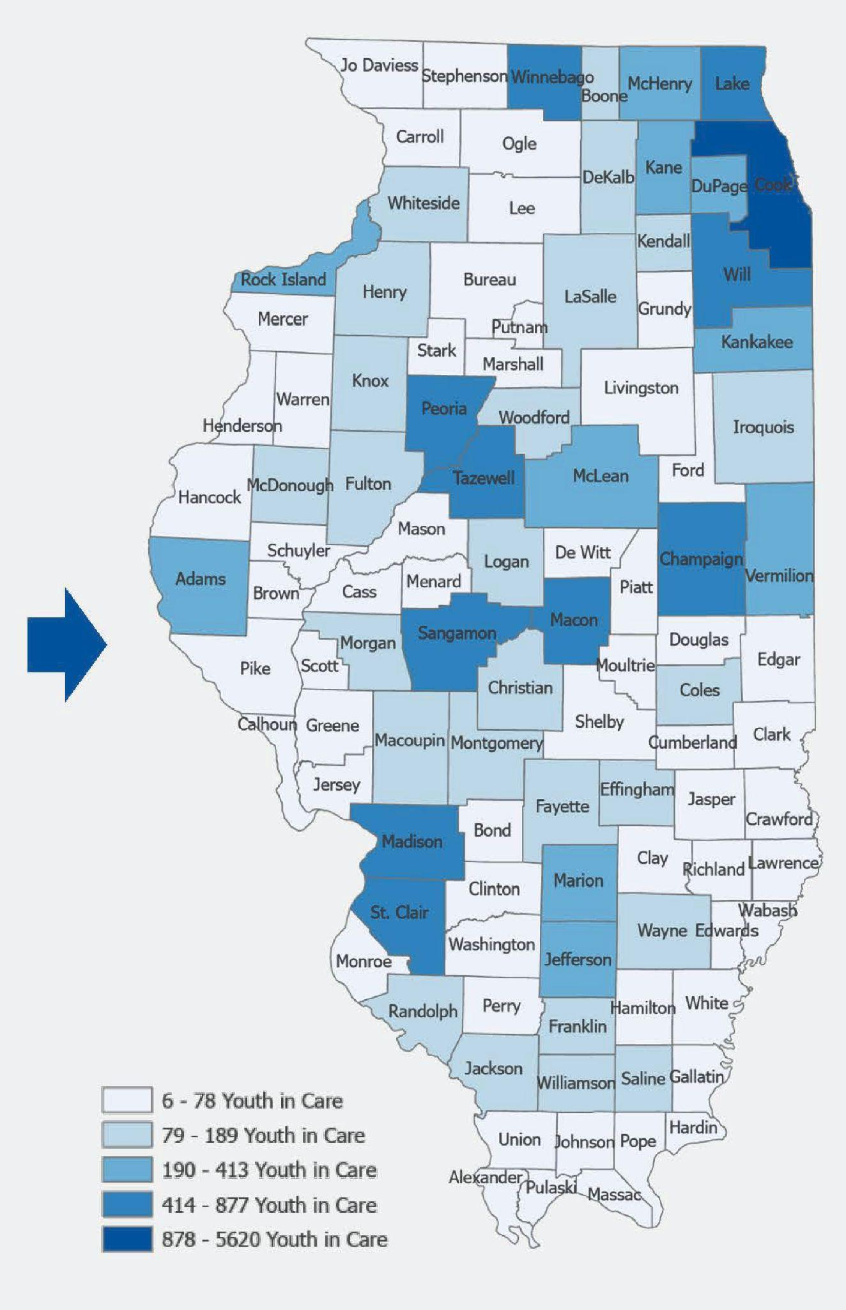
Illinois Youth in Care by County
Cook
Lake
Will
Winnebago
Peoria
Tazewell
Sangamon
Macon
Madison
St. Clair
Marion
Jefferson
Adams
Rock Island
Michael Lotspeich-Yadao, PHD, University of IL College of Applied Science Jan. 2022 IDCFS Youth-in-Care
Notes:
Lake County where Christ Church is has some of the highest in the state.

Slide 6


Attachment and Complex Trauma Struggle
Academics
Emotional Health
Physical Well-being
Relationships
Notes:
All adoptive and foster children struggle with academics, emotional health, physical well being and relationships.

Slide 7
WE MUST GET IT RIGHT!
Foster Children in Illinois
Adopted Children
80% need mental health support¹
Only 56% graduate from high school²
Only 8% complete a bachelor’s degree³
Adoptive children seek out mental health support at 3 times the rate of their peers
Adopted children are twice as likely to have learning differences⁴
¹National Conference of State Legislators 2022 ²Illinois School Report Card
³Chapin Hall 2022 ⁴Institute for Family Studies 2016 - American Association of Pediatrics
Notes:
It is important we get mental health care right —adopted and foster children are overrepresented in mental health care supports. The pevasive long term effects of trauma on adoptive parents and families means we meed evidence-based support after adoption is complete.
there are 300,000 adopted, foster and kinship children
15% of the school population.
At least three children in every class of 25 kids.
80% of foster children need mental health services
Adoptive children seek out mental health care at 3x the rate of their peers.

Slide 8
Mental Health Services Needed by Most Adopted Children
Notes:
“Adoption” does not take away the trauma (Reid 2009)

Slide 9
Age of Child at adoption placement/% of disruption

Slide 10
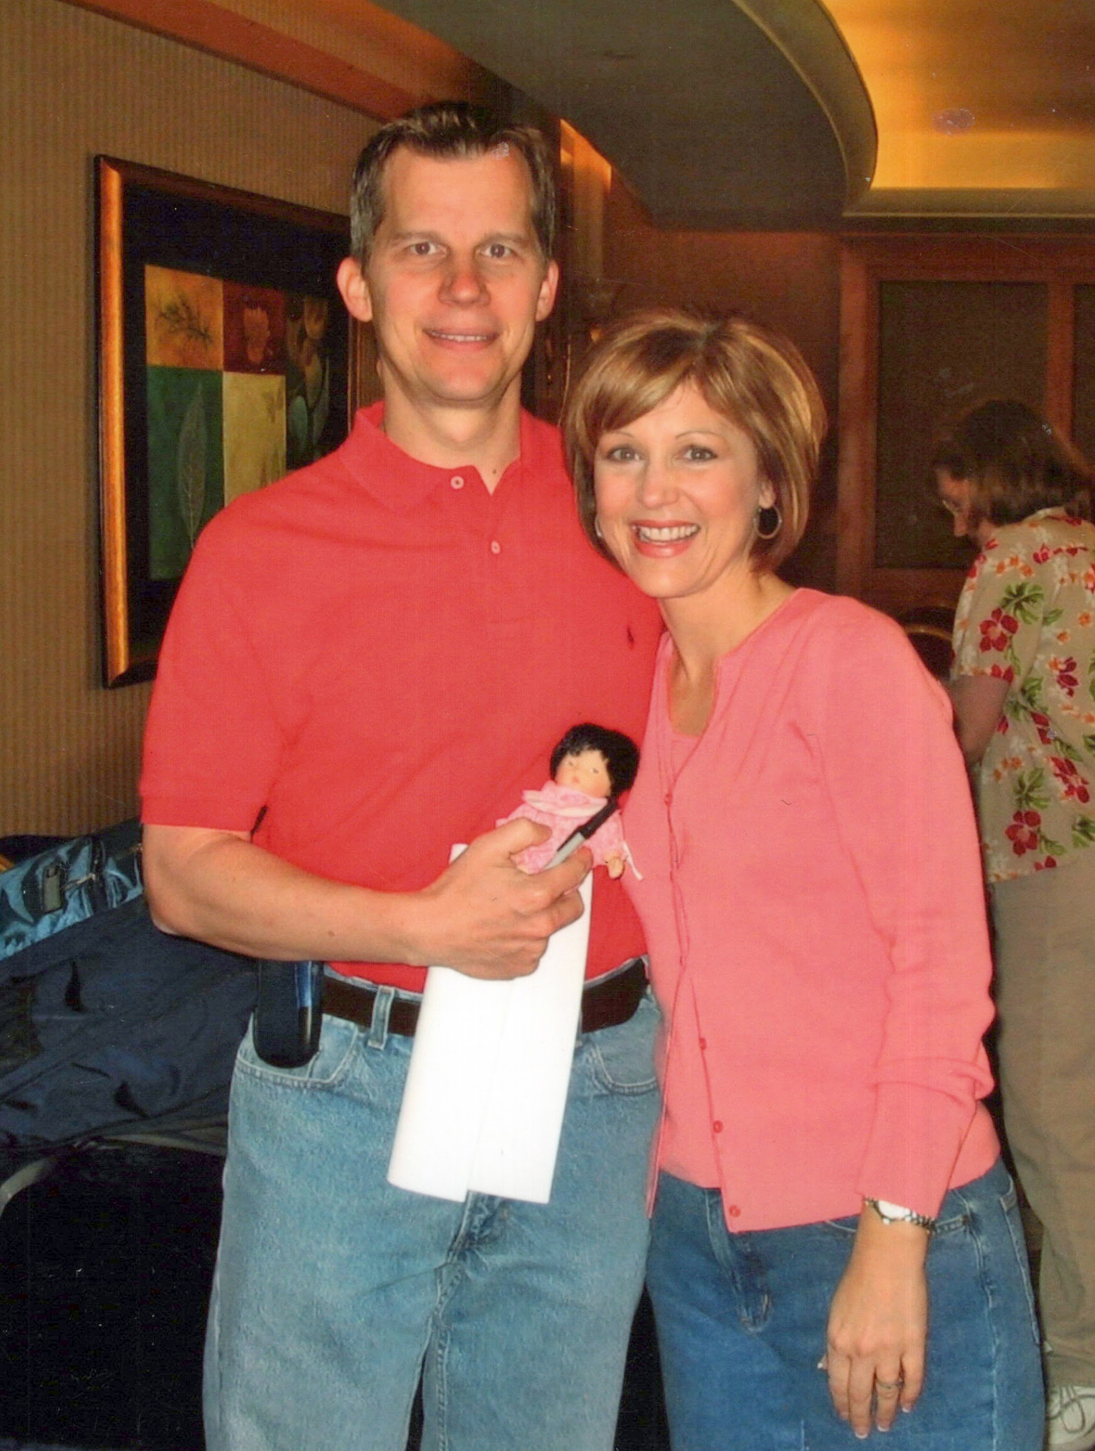
The Journey of Adoption
Love is not enough.
It starts with hope.
Behind every struggling child is a struggling and grieving parent.
Notes:
We had parented before, attended all the classes, had outside professionals lined up, a 504 in place. Went into a school meeting my daughter’s junior year thinking we were going to collaborate on strategies to help my daughter and instead were told they called DCFS on us for being emotionally abusive. This is the truth- We as parents, often times, cannot try harder, love more or fix anything. Our children have suffered trauma and we need to acknowledge that the trauma is to blame. Not the child. Not the parent. This is special needs parenting and we need to normalize support.

Slide 11
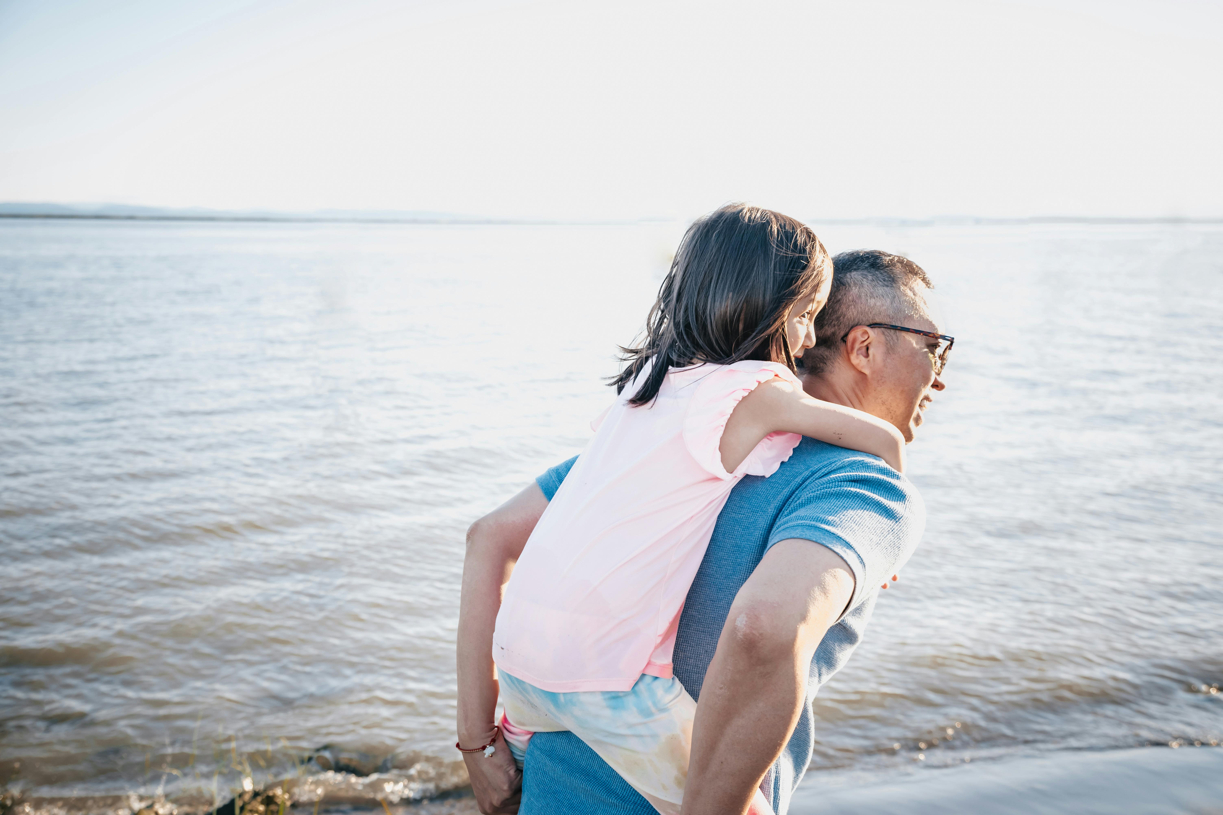
Parenting Children with Trauma
Parenting Children with Trauma
We Need to Normalize Support
Cannot try harder, love more or fix anything
Marathon, not a sprint
You don’t know what you don’t know
Grief in parenting kids from trauma
Reality is it’s all “special needs” parenting
Adoptive families trying their best
More time, money, energy and emotion
University of Indiana, 2007 study, funded by American Sociology Review
Notes:
Laugh -cry moments- Piano practice- sending back to China. Asking to do HW means you don’t love me. Kids who did well until their senior year and sabotaging success so they won’t have to leave home for college- Parents who live with camera’s and locks on doors to keep other kids in home safe due to unsafe behaviors. Grief and pain can come out as rage- Mild or severe. Parents must cope with defecating and urinating on furniture, breaking furniture, throwing bricks through care hoarding, stealing, sexual acting, stealing money, impulsive spending, gorging on food. - Secret Amazon orders, sending to friends house.

Slide 12
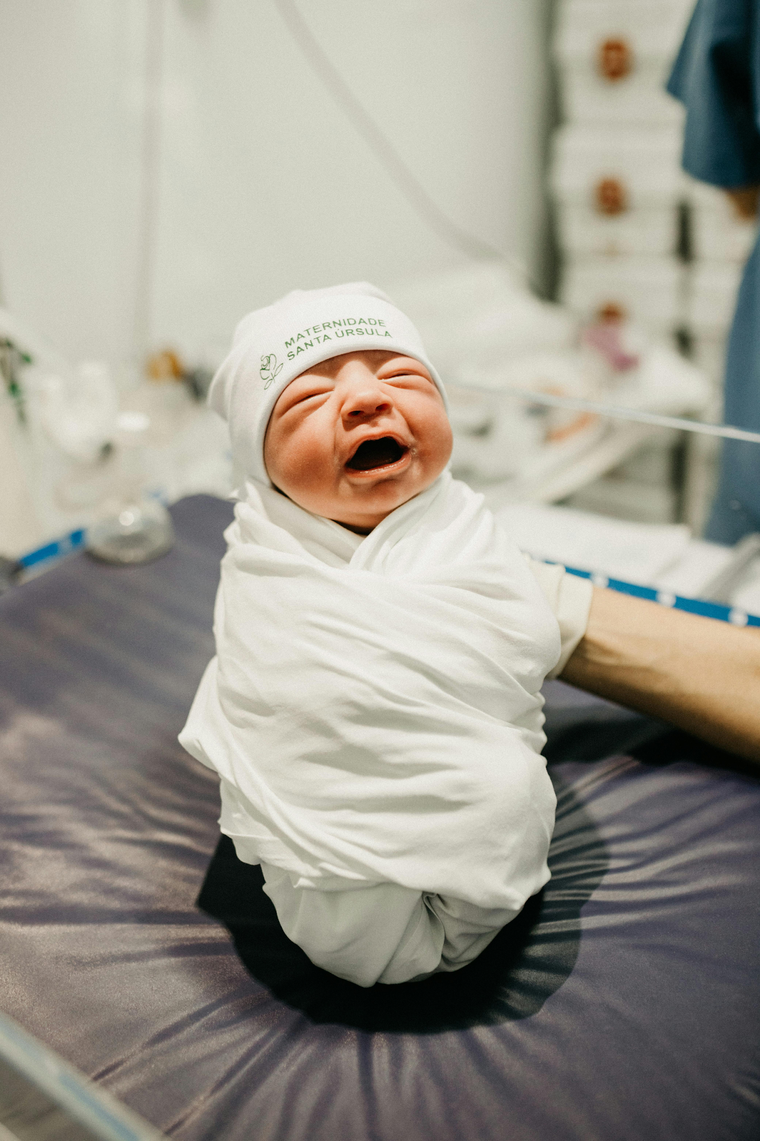
What is Attachment Trauma?
Separation from birth mother or any traumatic past experience associated with an attachment figure that damages the ability to feel safe and secure in one’s primary relationship.

Slide 13
Other Complex Traumas
Prenatal Stress
Traumatic Birth
Hospitalization After Birth
Orphanage Care
Exposure to Alcohol and Drugs
Neglect
Physical Abuse
Sexual Abuse

Slide 14
Fear and Stress
What Does It Do?
DISRUPTS healthy neurodevelopment
CHANGES the brain, beliefs and biology
CREATES lack of trust, self-worth, efficacy and regulation
AFFECTS whole body from nervous system to brain
Notes:
Disrupts healthy neurodevelopment -often much younger emotionally than their chronological age
Changes the brain, beliefs and biology- kids are always on a high stage of alert
Creates lack of trust, self-worth, self-efficacy, self-regulation- kids are triggered by small events
Effects are high stress, inability to access logical thinking or to problem-solve

Slide 15
Negative Beliefs
It's not safe to trust parents
to care
I’m all alone
Parents will leave
I’m not good enough
Parents are mean
I’m not safe
It’s not safe to trust
I don’t belong
Internal Working Model of Attachment Trauma
Integrative Parenting, Strategies for Raising Children Affected by Attachment Trauma (Wesselmann, Schweitzer, Armstrong 2014)

Slide 16
Adaptive Thoughts Impact Behaviors
I must be ready to run
I must take care of myself and my own needs.
I must fight to defend myself
I must keep a wall up and not care about others.
I must be vigilant to danger and mistrust at all times
I must take what I need when I get the chance.
“Survival Skills” Integrative Parenting, Strategies for Raising Children Affected by Attachment Trauma (Wesselmann, Schweitzer, Armstrong 2014)
Notes:
Adaptive Thoughts often referred to as “Survival Skills”- Their decisions are made impulsively, reactively and out of fear. Doesn’t mean the child doesn’t want love. Just doesn't know how to receive it and feel safe.

Slide 17

FEAR AND STIGMA
Trauma Behaviors and Emotions Impact Families
Child loses friends¹
Family loses friends¹
Siblings neglected¹
Untrained professionals blame parents or child¹
Disproportionate effect on families of color²
¹Young and Rabiner, 2015 ²Hartinger, Saunders, Trouteaud 2015
Notes:
Families are suffering in silence afraid they will be judged. Racial disparities/ Parents and families encounter many situations due to trauma that typical families do not deal with. Stealing, lying. rage, stress, anxiety, depression, sexual behaviors, sensory issues- too loud, too shy, ADHD activities- too rough and overaggressive. Some families have cameras in their homes, locked doors.

Slide 18

Family Concerns
Are school personnel trained?
How will peers treat them?
What to share with others?
How will kids be perceived?
How will parents be perceived?
Families are suffering in silence
Notes:
Families are suffering in silence.
Are school personnel trained on attachment and complex developmental trauma, FASD and trauma-informed responses?
Families are transracial, multi-generational- “conspicuous families”- how will peers treat them.
What to share with others- parents want perspective over pathology.
How will kids be perceived? Social-emotional development lags typical peers.
How will parents be perceived? Kids need more scaffolding than others and behaviors at home can be much different than at school?

Slide 19
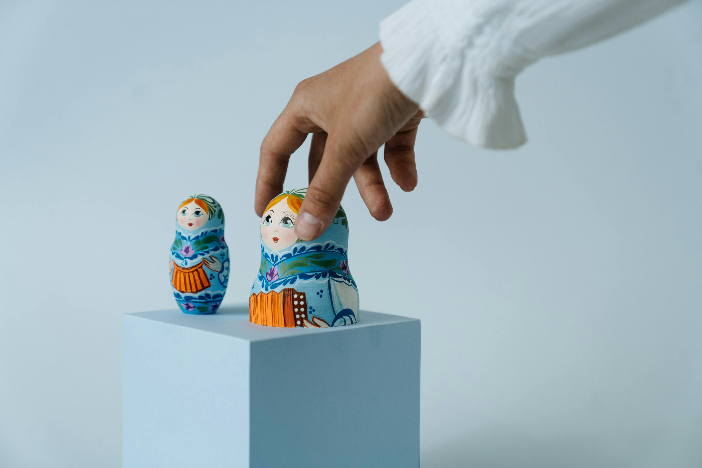
Barriers to Getting Support
Barriers to Getting Support
Unaware of where to find services
Unaware of what services to look for
Do not want to ask for help
Past services not helpful
Could not afford services
Adoptive child uncooperative
Underserved Adoptive Families: Disparities in Post adoption: Access to Information, Resources and Services 2015 (Hartinger-Saunders, Trouteaud)

Slide 20

proper support is needed
The cycle continues with broken relationships and families without it…
Truth is:
Not bad kids
Not bad parents
Not bad schools
Training on attachment trauma and support is vital
Notes:
Compassion and understanding is needed in order to serve these children well. We want a unified approach with a shared perspective.
These are not bad kids.
These are not bad parents.
These are not bad schools.
What is bad is trauma. And we need to be united together against it to heal our children.

Slide 21

How we change the world!
How we change the world!
Notes:
It’s how we change the world.

Slide 22

Partnerships for Better
Training and Support
Partnerships for Better
Training and Support
Parents
Schools
Support professionals
Policymakers
Churches
Communities
Notes:
Parents, schools, support, professionals, churches, and communities. Kids do better with the addition of helpful people in their lives
Stronger children and families leads to stronger communities.

Slide 23

Sequoia Families
Peer to peer support
Education
Resources
In-person meetings
Virtual meetings
Family gatherings

Slide 24
School and Organizational Outreach
Personal outreach and education
Conferences
Webinars
Mental health organizations
Government agencies
Legislators

Slide 25
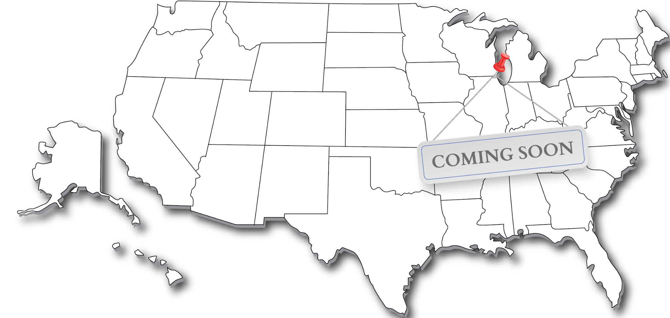
OUR iCARE IMPACT
Sequoia Families
In-person and Virtual support
34 families with 64 adopted children
NTI Adoption Competency Training committed in FIVE Northern Illinois School Districts
(30-40 trained professionals)
HJ0063 (2024)
SEL (Social Emotional Learning) Symposium Hub 2
Annual IASSW, IASB/IASA/IASBO Conferences
DeKalb Institute Days
Notes:
I still run into people in the community who don’t know about us. Support for Parents- links to trainings- lists of ‘iCARE4 Adoptive And Foster Families” schools and professionals -Sequoia Families-

Slide 26
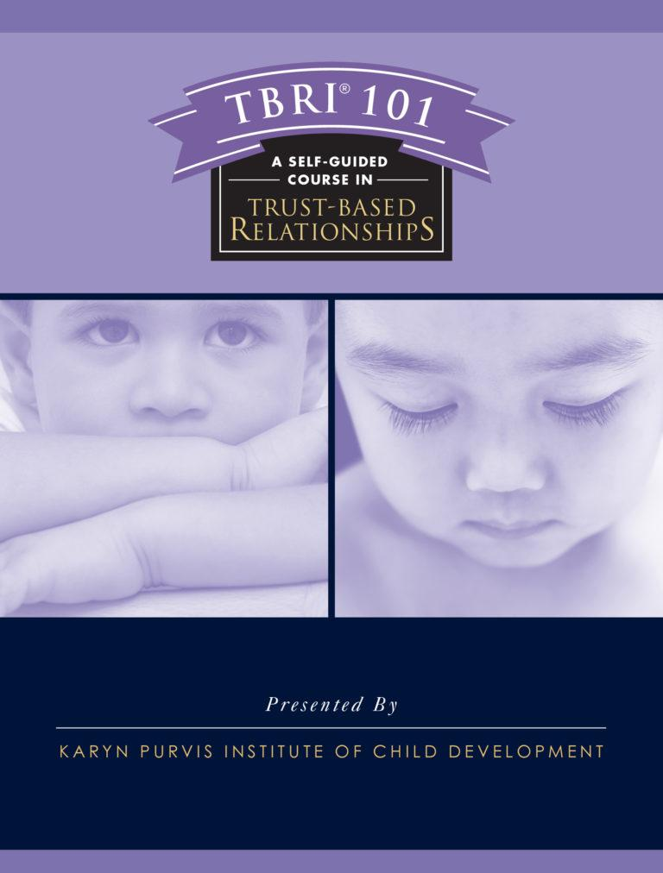
TBRI® FOR PARENTS AND CLASSROOMS

Slide 27
TBRI® TRAINING IS PROVEN
Trust Based Relational Intervention (TBRI®):
Attachment-based and trauma-informed
Applies to all kids
Designed for use in families, schools, churches and youth organizations
Empowering, connecting and correcting principles
Karyn Purvis Institute of Child Development at TCU
Online with facilitators and in-person

Slide 28


NTI FOR SCHOOLS AND MENTAL HEALTH PROFESSIONALS
Approved by NBCC and NASW
Notes:
NTI for Schools

Slide 29
WHAT IS ADOPTION COMPETENCY?
Psychological impact of adoption
Loss as a core issues
The impact of trauma
The role and impact of attachment

Slide 30
NTI TRAINING IS PROVEN
National Training Initiative Center for Adoption Support and Education - (C.A.S.E.) $9 million grant children’s bureau
Improves understanding of trauma of adopted, foster and kinship children Applies to immigrants and children of divorce
Improves understanding of grief and loss
$9 Million Children’s Bureau Grant
Programs for Child Welfare, Mental Health Professionals and Schools
FREE, Virtual and Self-paced
Better Outcomes for Kids!

Slide 31
NTI and TBRI® Training is Effective
CHILDREN
PARENTS
Empowered and safe
Self-worth
Learn how to connect in relationships
Understand the origin of behaviors
Learn to manage and not personalize
Have realistic expectations
Applies to schools also!

Slide 32
More Work to Be Done
More Work to Be Done
Offer evening training programs
Hire grant writing agency or contractor
Communication beyond Facebook
Outreach to adoption and education conferences
Foster bi-directional support for families
Hire TBRI® professionals and Social Worker on staff
We need your help!
Notes:
Conferences give credibility and leads- three from the SEL Conference. A big one coming up in February- costs money to attend, have a booth, fly out, hotel. Flyers and give aways.
The Story of Sequoia Trees

Slide 33

CHURCHES HAVE AN IMPORTANT ROLE!
CHURCHES HAVE AN IMPORTANT ROLE!
Biblical mandate to care for orphans
Ministry of compassion
Strengthening families
Community outreach
Notes:
Biblical Mandate to Care for Orphans - to offer love and rebuild trust-
Ministry of Compassion - show Love and Kindness
Strengthening Families - Families are Foundation to Society
Community Outreach
Take Training
Offer Financial Support

Slide 34

CHURCH SUPPORT
CHURCH SUPPORT
Heals Hearts And Strengthens Families
Your Donations:
Your Impact:
Grow programs
Expand reach to families and schools
Provides effective mental health supports for children
Ensures permanent families for children
Helps schools engage families
Supports parents
Strengthens families and communities
Notes:
We are a safe bet- already proven and effective.

Slide 35

BUILDING A MOVEMENT FOR:
BUILDING A MOVEMENT FOR:
Resilient Children
・
Strong Families
・
Flourishing Communities
Notes:
Benefits to Parents/Schools/ Professionals/ Churches/Communities

Slide 36

PERMANENCE IS NOT THE END
PERMANENCE IS NOT THE END
It’s Just The Beginning.
Parents
Schools
Support Professionals
Churches
Communities
Support Builds Hope
Notes:
Need partnership and support-
Parents
Schools
Support Professionals
Churches
Communities
Stronger Children and Families leads to stronger communities.

Slide 37
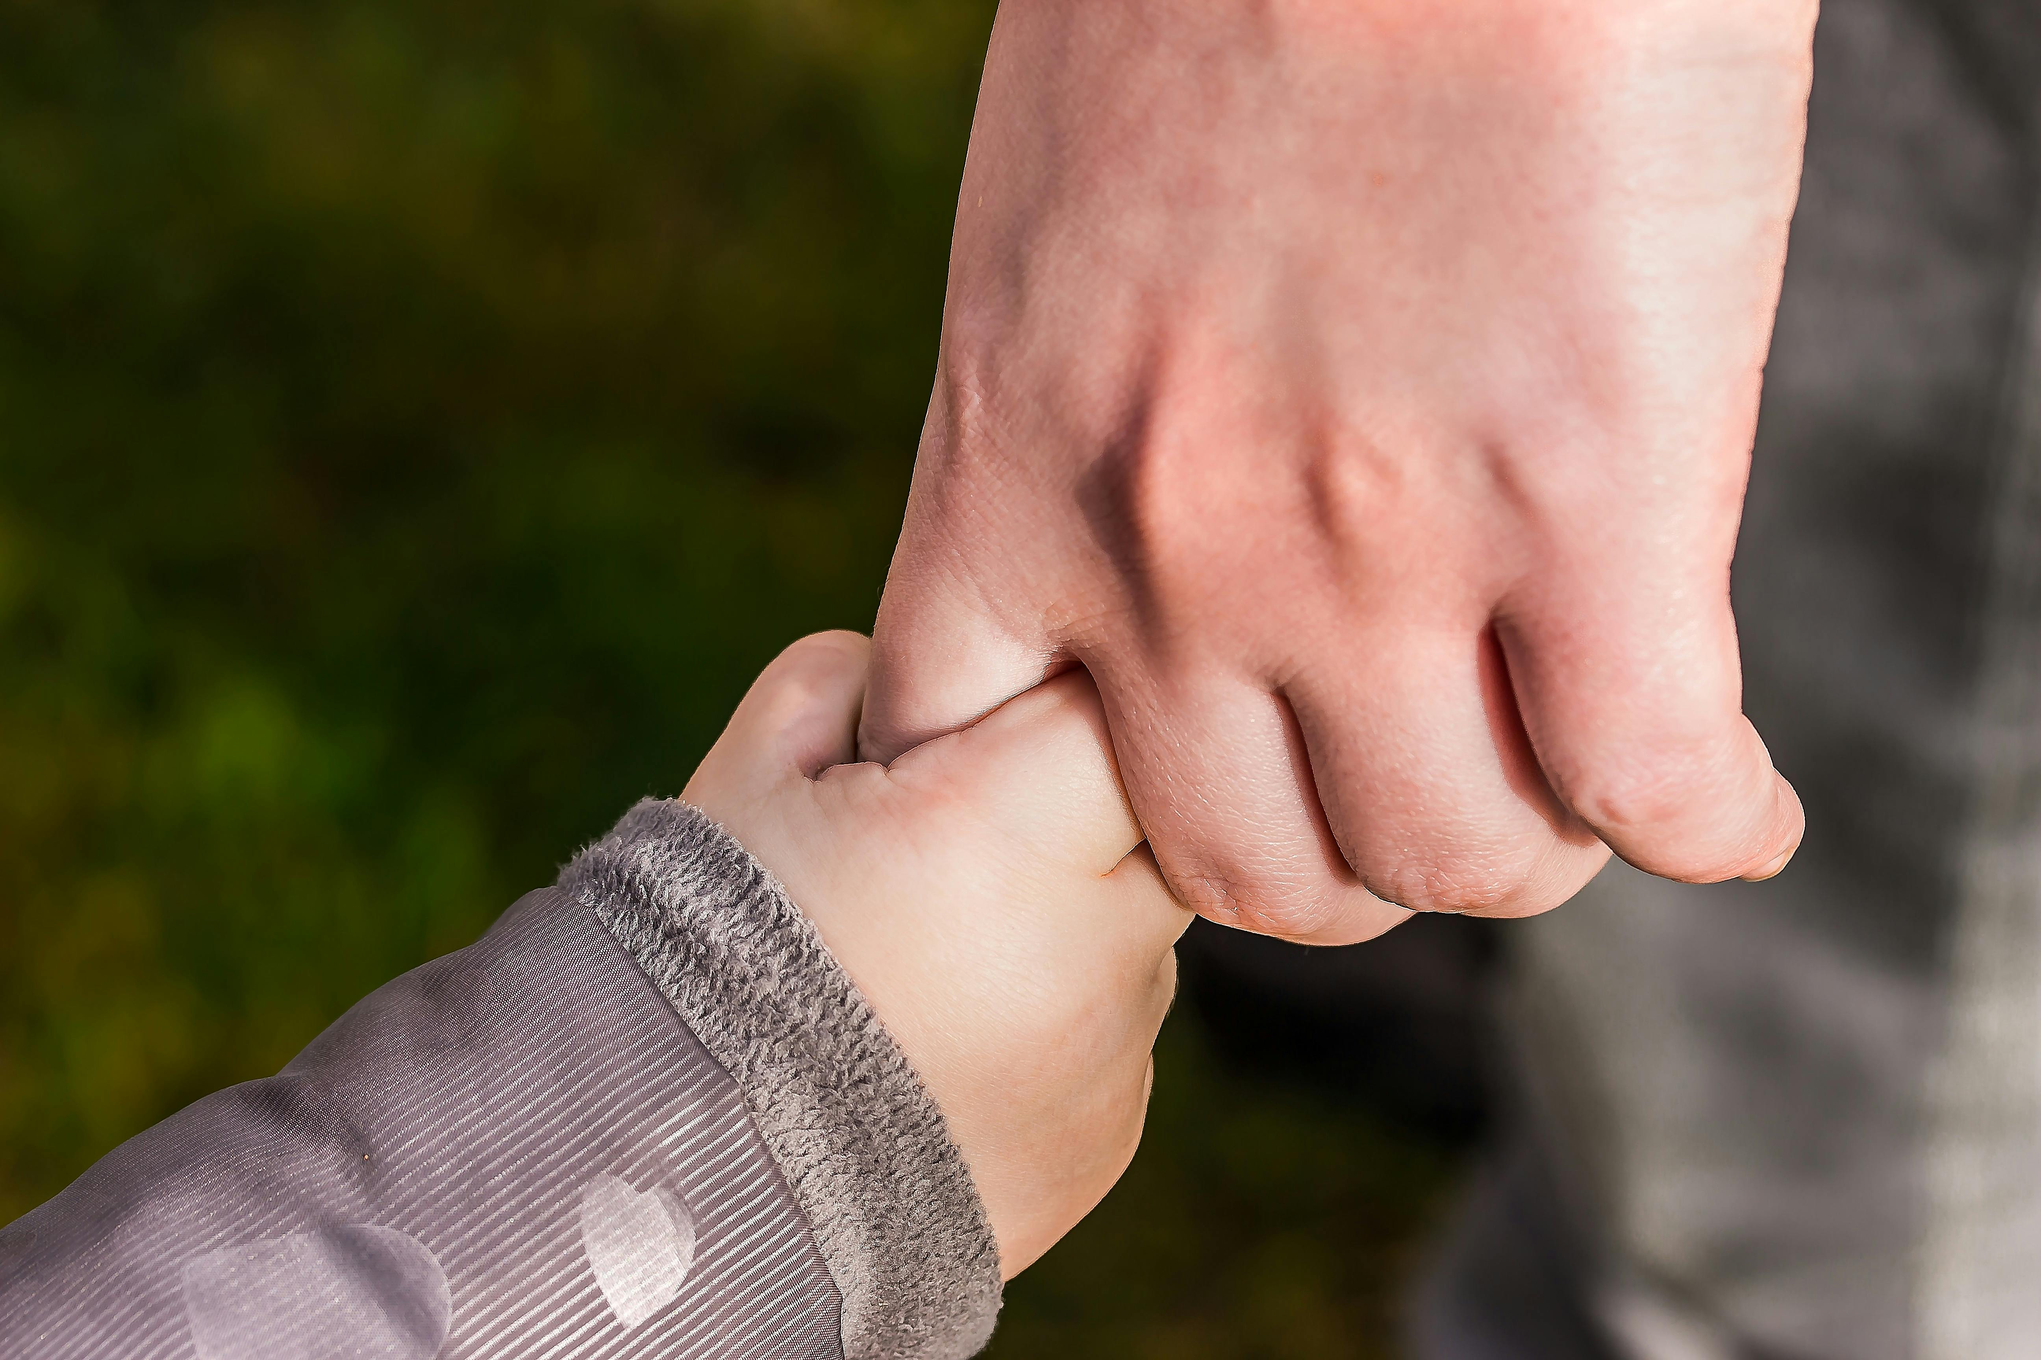
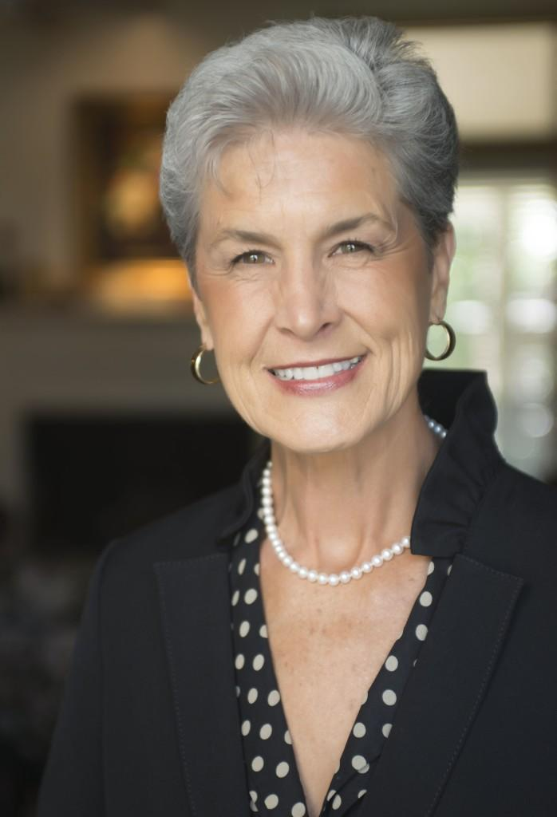
Dr. Karyn Purvis
Co-Founder of the Karyn Purvis Institute of Child Development & Co-Creator of TBRI®
“ If I could tell you my dream for every child in the world, it would be to imagine a world where the cry of every child is met by a loving compassionate adult.”
Notes:
Compassion, understanding, right training and tools, shared perspective by parents, schools and professionals
Need for trained parents, professionals, and schools to know.
It is not what is wrong with you- it’s what has happened to you? Compassion, Understanding and Unity

Slide 38

Notes:
Together, Caring for Every Child, Every Family.

Slide 39
REFERENCES:
A Need to Know – Enhancing Adoption Competency Among Mental Health Professionals
David M. Brodzinsky, PHD, August 2013
The Donaldson Adoption Institute
Keeping the Promise: The Critical Need for
Post-Adoption Services to Enable Children and Families to Succeed-Policy and Practice Perspective
Harmony Adoption Services and the Evan B. Donaldson Adoption Institute, August 2010

